Slide 1
Data Structure and Algorithm DSA

Slide 2
Time complexity
The complexity analysis (Time) of an algorithm is very hard if we try to analyze exact.
So, The complexity of an algorithm is analyzed in terms of a mathematical function of the size of the input.
The algorithm is analyzed in term of bound by understanding the growth of the function.
For this purpose we need concept of asymptotic notations.
A line that continually approaches a given curve but does not meet at any finite distance.
Asymptotic Notation:
It primarily deal with running time of algorithm.

Slide 3



Definition: Let f and g be functions from the set of integers or the set of real numbers to the set of real numbers. We say that f(n) is O(g(n) (read as f(n) is big-oh of g(n) if there are constants C and k such that
whenever n>k.
For example: If
so that we can infer that f(n)=O(g(n)) with g(n)=n, C=6 and n>1.
Hence the time complexity of the factorial algorithm is O(n) i.e linear complexity.

Slide 4
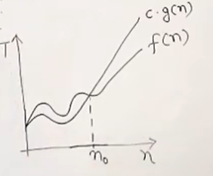
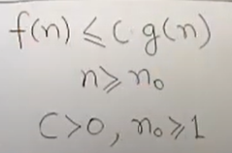

Big - O

Slide 5
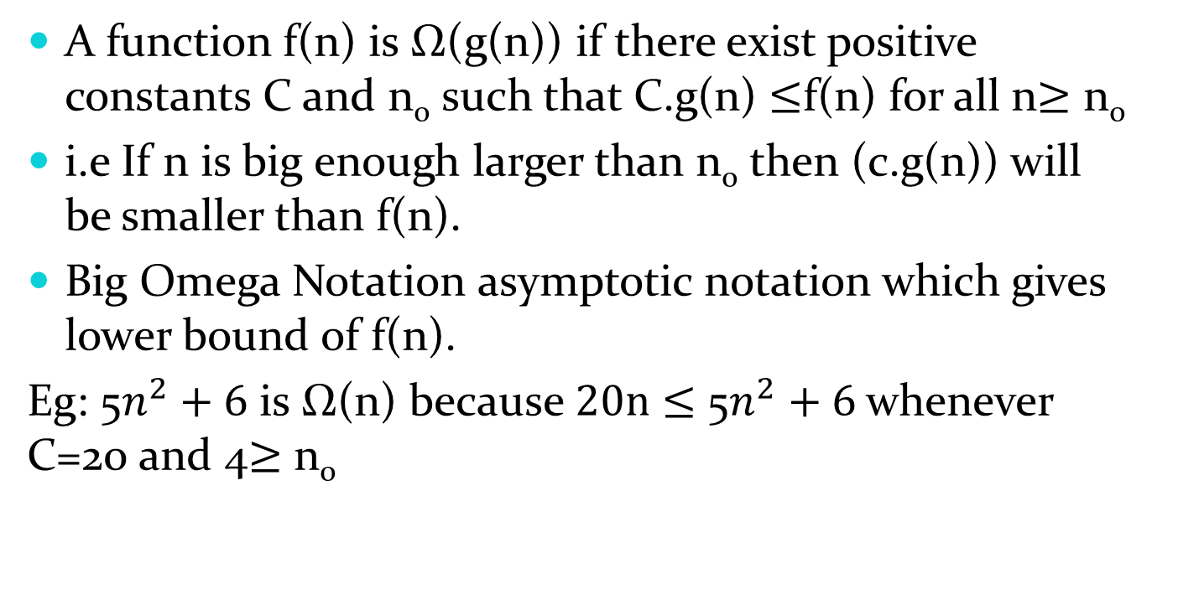
Big Omega (Ω) Notation:
A function f(n) is Ω(g(n)) if there exist positive constants C and n₀ such that C.g(n) $≤$f(n) for all n$≥\text{n}\text{0}$
i.e If n is big enough larger than n₀ then (c.g(n)) will be smaller than f(n).
Big Omega Notation asymptotic notation which gives lower bound of f(n).
Eg: 5$n^{2}+6$ is Ω(n) because $20n$ $≤$ 5$n^{2}+6$ whenever C=20 and 4$≥$ n₀

Slide 6
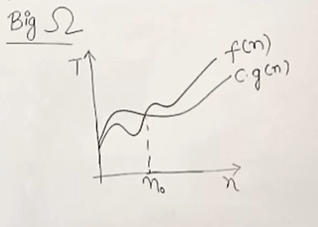
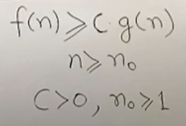


Slide 7
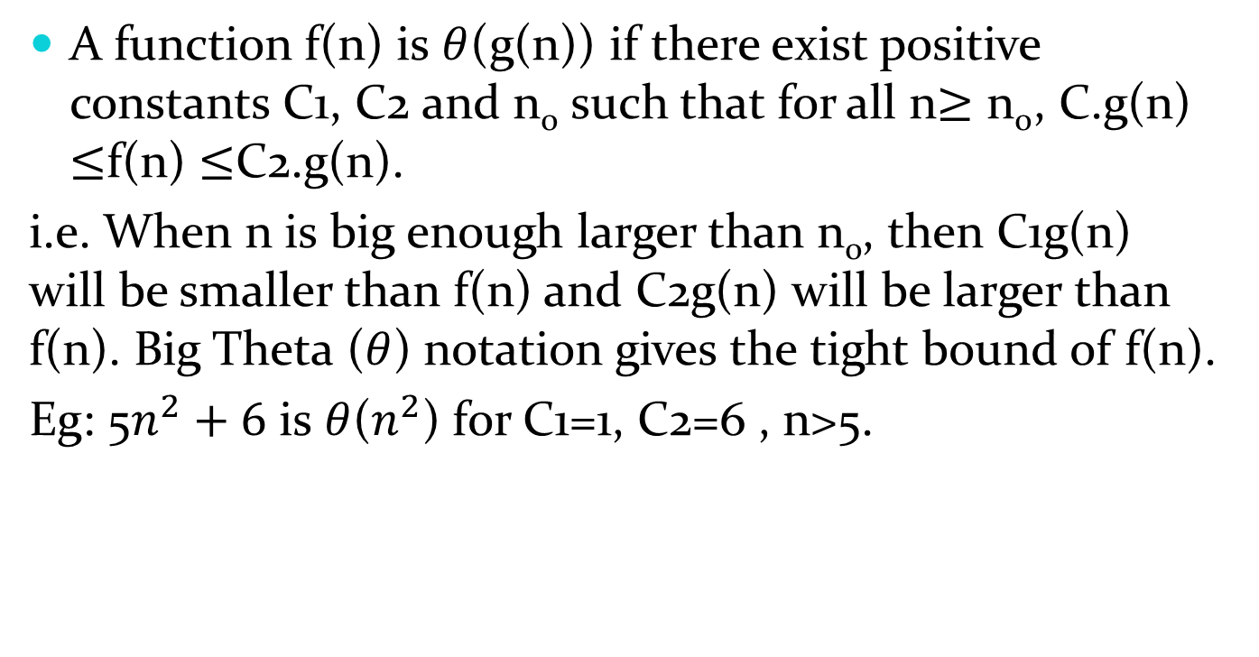

Big Theta$(θ)$ Notation:
A function f(n) is $θ$(g(n)) if there exist positive constants C1, C2 and n₀ such that for all n$≥\text{n}\text{0}$, C.g(n) $≤$f(n) $≤$C2.g(n).
i.e. When n is big enough larger than n₀, then C1g(n) will be smaller than f(n) and C2g(n) will be larger than f(n). Big Theta ($θ$) notation gives the tight bound of f(n).
Eg: 5$n^{2}+6$ is $θ$($n^{2}$) for C1=1, C2=6 , n>5.

Slide 8
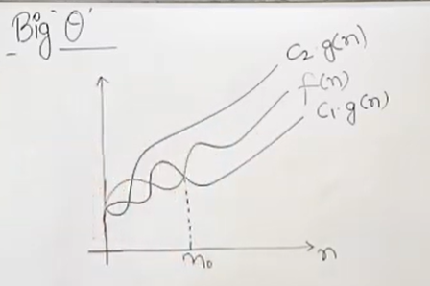
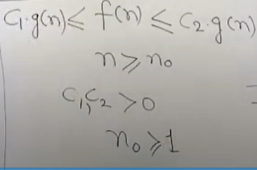


Slide 9
Worst Case Analysis:
In worst case analysis, we calculate upper bound on running time of an algorithm.
We must know the case that causes maximum number of operations to be executed.
For linear search the worst case happen when the elements to be searched is not present in the array or list.
When the element is not present , the search function compare with all the element of array one by one.
Worst case analysis is done must of the time as it, guarantees an upper bound on the running time of an algorithm.

Slide 10
Average Case:
In average case analysis, we take all possible inputs and calculate computing time for all inputs.
Sum all the calculated values and divide the sum by total number of inputs.
We must know or predict distribution of case for average case analysis.
That is why, it is not easy to do in most of the practical cases and it is rarely done.

Slide 11
Best Case Analysis:
In best case analysis, we calculate lower bound on running time of an algorithm. Here, we must know the case that causes minimum number of operations to be executed. In the linear search problem, the best case occurs when x is present at the first location. The best case analysis is bogus(unclear). Guarantees a lower bound on an algorithm doesn’t provide sufficient information about a time the algorithm takes.

Slide 12
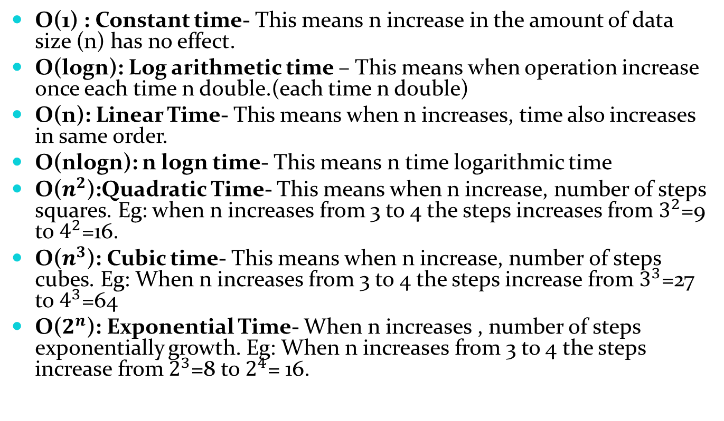
Based on Big-Oh notation, the algorithms can be categorized as follows:
O(1) : Constant time- This means n increase in the amount of data size (n) has no effect.
O(logn): Log arithmetic time – This means when operation increase once each time n double.(each time n double)
O(n): Linear Time- This means when n increases, time also increases in same order.
O(nlogn): n logn time- This means n time logarithmic time
O($n^{2}$):Quadratic Time- This means when n increase, number of steps squares. Eg: when n increases from 3 to 4 the steps increases from $3^{2}$=9 to $4^{2}$=16.
O($n^{3}$): Cubic time- This means when n increase, number of steps cubes. Eg: When n increases from 3 to 4 the steps increase from $3^{3}$=27 to $4^{3}$=64
O($2^{n}$): Exponential Time- When n increases , number of steps exponentially growth. Eg: When n increases from 3 to 4 the steps increase from $2^{3}$=8 to $2^{4}$= 16.

Slide 13
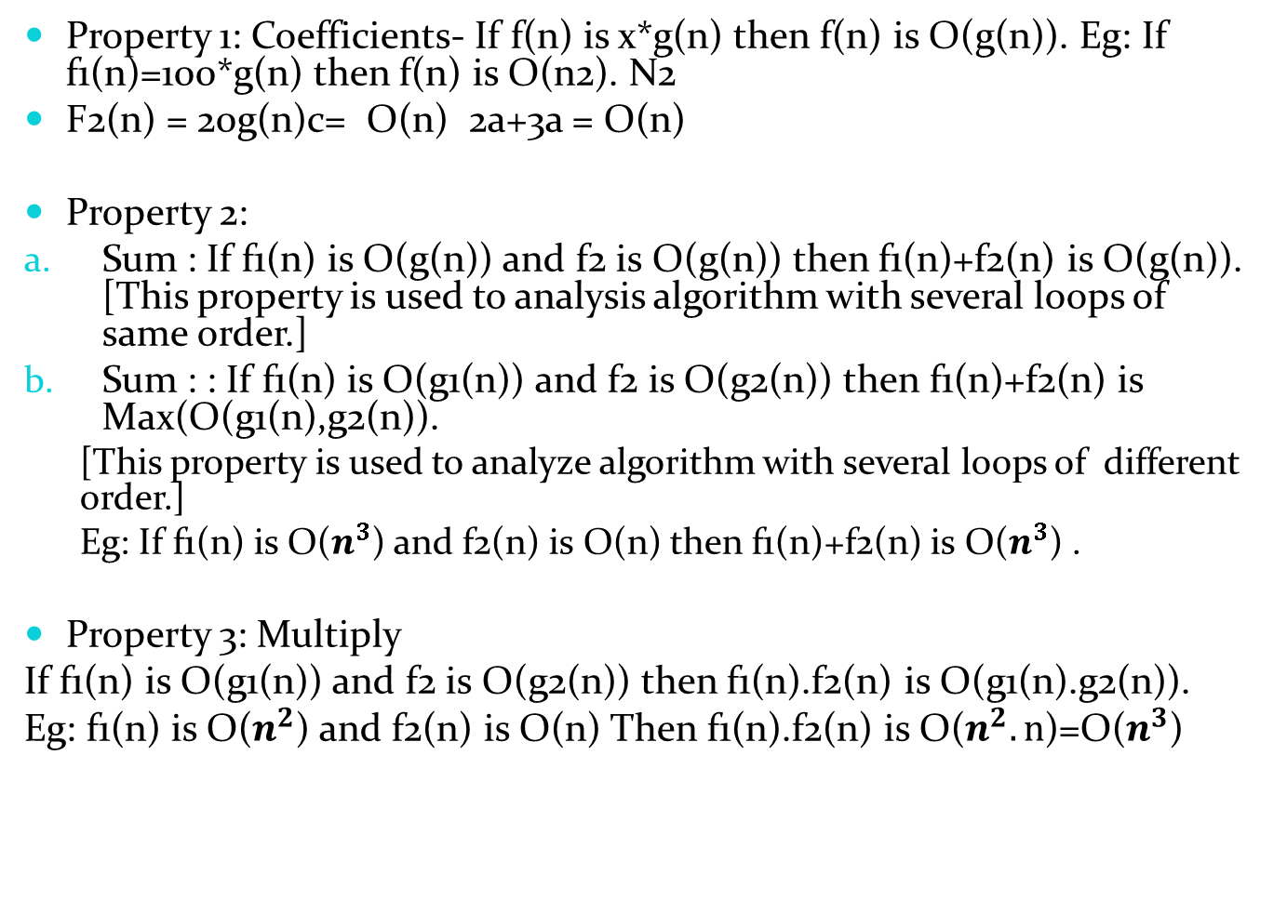
Properties of Big-Oh Notation:
Property 1: Coefficients- If f(n) is x*g(n) then f(n) is O(g(n)). Eg: If f1(n)=100*g(n) then f(n) is O(n2). N2
F2(n) = 20g(n)c= O(n) 2a+3a = O(n)
Property 2:
Sum : If f1(n) is O(g(n)) and f2 is O(g(n)) then f1(n)+f2(n) is O(g(n)). [This property is used to analysis algorithm with several loops of same order.]
Sum : : If f1(n) is O(g1(n)) and f2 is O(g2(n)) then f1(n)+f2(n) is Max(O(g1(n),g2(n)).
[This property is used to analyze algorithm with several loops of different order.]
Eg: If f1(n) is O($n^{3}$) and f2(n) is O(n) then f1(n)+f2(n) is O($n^{3}$) .
Property 3: Multiply
If f1(n) is O(g1(n)) and f2 is O(g2(n)) then f1(n).f2(n) is O(g1(n).g2(n)).
Eg: f1(n) is O($n^{2}$) and f2(n) is O(n) Then f1(n).f2(n) is O($n^{2}.n$)=O($n^{3}$)

Slide 14
Thank you!

